Slide 1
RM5151 RESEARCH METHODOLOGY AND IPR

Slide 2
RESEARCH PROBLEM

Slide 3
Meaning of Research Problem
The formulation of a research problem is the first and most important step of the research process.
It is like the identification of a destination before undertaking a journey. In the absence of a destination, it is impossible to identify the shortest – or indeed any – route.
Similarly, in the absence of a clear research problem, a clear and economical plan is impossible.
To use another analogy, a research problem is like the foundation of a building. The type and design of the building are dependent upon the foundation.
If the foundation is well designed and strong you can expect the building to be also.
The research problem serves as the foundation of a research study: if it is well formulated, you can expect a good research work.

Slide 4
Meaning of Research Problem
According to Kerlinger: “If one wants to solve a problem, one must generally know what the problem is. It can be said that a large part of the problem lies in knowing what one is trying to do (1986: 17)”
A research problem may take a number of forms, from the very simple to the very complex.
The way you formulate a problem determines almost every step that follows: the type of study design that can be used; the type of sampling strategy that can be employed; the research instrument that can be used or developed; and the type of analysis that can be undertaken.
The formulation of a problem is like the ‘input’ to a study, and the ‘output’ – the quality of the contents of the research report and the validity of the associations– is entirely dependent upon it.

Slide 5
Meaning of Research Problem
Suppose your area of interest is depression. Further suppose you want to conduct a research study regarding services available to patients with depression living in a community.
If your focus is to find out the types of service available to patients with depression, the study will dominantly be descriptive and qualitative in nature.
These types of studies fall in the category of qualitative research and are carried out using qualitative research methodologies.
On the other hand, if you want to find out the extent of use of these services, that is the number of people using them, it will dominantly use quantitative methodologies even though it is descriptive in nature describing the number of people using a service.

Slide 6
Sources of Research Problems

Slide 7
Sources of research problems
This is about particular relevance if you have not yet selected a research topic and do not know where to start.
If you have already selected your topic or question, go to the next section.
Most research in the humanities revolves around four Ps:
People;
Problems;
Programmes;
Phenomena.

Slide 8
Sources of research problems
In practice, most research studies are based upon at least a combination of two Ps.
You may select a group of individuals (a group of individuals – or a community as such – ‘people’), to examine the existence of certain issues or problems relating to their lives,
to ascertain their attitude towards an issue (‘problem’),
to establish the existence of a regularity (‘phenomenon’) or
to evaluate the effectiveness of an intervention (‘programme’).
For example, the relationship between unemployment and street crime, smoking and cancer.

Slide 9
Aspects of Research Study
Every research study has two aspects: the people provide you with the ‘study population’, whereas the other three Ps furnish the ‘subject areas’.
Your study population – individuals, groups and communities – is the people from whom the information is collected.
Your subject area is a problem, programme or phenomenon about which the information is collected.

Slide 10
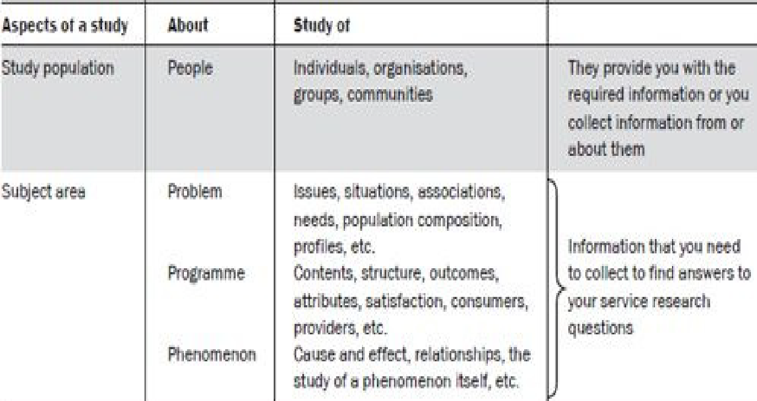

Slide 11
Sources of research problems
You can study a problem, a programme or a phenomenon in any academic field or from any professional perspective.
For example, you can measure the effectiveness of a programme in the field of health, education, social work, industrial management, public health, nursing, health promotion or welfare.
The concept of 4Ps is applicable to both quantitative and qualitative research.
The main difference at this stage is the extent of their specificity, dissection, precision, and focus.

Slide 12
Considerations in selecting a research problem

Slide 13
Considerations in selecting a research problem
Interest
Interest should be the most important consideration in selecting a research problem.
A research endeavour is usually time consuming, and involves hard work and possibly unforeseen problems.
Magnitude
You should have sufficient knowledge about the research process to be able to visualize the work involved in completing the proposed study.
Narrow the topic down to something manageable, specific and clear.
It is extremely important to select a topic that you can manage within the time and with the resources at your disposal.

Slide 14
Considerations in selecting a research problem
Measurement of concepts
If you are using a quantitative study, make sure you are clear about its indicators and their measurement.
For example, if you plan to measure the effectiveness of a health promotion programme, you must be clear as to determines effectiveness and how it will be measured.
Do not use concepts in your research problem that you are not sure how to measure.
Level of expertise
Make sure you have an adequate level of expertise for the task you are proposing.
Learn during the study and may receive help from your research supervisor and others, but remember that you need to do most of the work yourself.

Slide 15
Considerations in selecting a research problem
Relevance
Select a topic that is of relevance to you as a professional.
Ensure that your study adds to the existing body of knowledge, bridges current gaps or is useful in policy formulation.
This will help you to sustain interest in the study.
Availability of data
If your topic entails collection of information from secondary sources like office records, client records, census or other already-published reports, etc.,
Make sure that this data is available and in the format you want before finalizing your topic.

Slide 16
Considerations in selecting a research problem
Ethical issues
Another important consideration in formulating a research problem is the ethical issues involved.
In the research study, the study population may be adversely affected directly or indirectly.
How ethical issues can affect the study population and how ethical problems can be overcome should be thoroughly examined at the problem-formulation stage.

Slide 17
Formulating a Research Problem

Slide 18
Steps in Formulating a Research Problem
The formulation of a research problem is the most crucial part of the research journey as the quality and relevance of your research project entirely depends upon it.
The process of formulating a research problem consists of a number of steps.
Working through these steps presupposes a reasonable level of knowledge in the subject area within which the study is to be undertaken and the research methodology itself.
A brief review of the relevant literature helps enormously in broadening this knowledge base.

Slide 19
Steps in Formulating a Research Problem
Step 1 : Identify a broad field or subject area of interest to you.
Think about the field in which you would like to work after graduation.
This will help you to find an interesting topic, and one which may be of use to you in the future.
For example, if you are a social work student, you might take to research in one of these areas of youth welfare, refugees or domestic violence after graduation,.
Or if you are studying marketing you might be interested in researching consumer behavior.

Slide 20

Steps in Formulating a Research Problem
Step 2 : Dissect the broad area into subareas
There are many aspects in broad areas mentioned in the above youth welfare, refugees, domestic violence, consumer behavior.
For example, there are many aspects and issues in the area of domestic violence, illustrated below

Slide 21
Steps in Formulating a Research Problem
Step 2 : Dissect the broad area into subareas
Similarly, you can select any subject area from other fields such as community health or consumer research and go through this dissection process.
While preparing this list of subareas you should also consult others who have some knowledge of the area and the literature in your subject area.
Once you have developed an exhaustive list of the sub areas from various sources, proceed to the next stage where you select what will become the basis of your enquiry.

Slide 22
Steps in Formulating a Research Problem
Step 3 : Select what is of most interest to you.
It is neither advisable nor feasible to study all subareas. Out of this list, select issues or subareas about which you are passionate.
This is because your interest should be the most important determinant for selection, even though there are some other considerations which have been discussed in the previous section.
Go through your list and delete all those subareas in which you are not very interested.
You will find that towards the end of this process, it will become very difficult for you to delete anything further.
Need to continue until you are left with something that is manageable considering the time available to you, your level of expertise and other resources needed to undertake the study.
Once you are confident that you have selected an issue you are passionate about and can manage, you are ready to go to the next step.

Slide 23
Steps in Formulating a Research Problem
Step 4 : Raise research questions.
At this step ask yourself, ‘What is it that I want to find out about in this subarea?’
Make a list of whatever questions come to your mind relating to your chosen subarea.

Slide 24
Steps in Formulating a Research Problem
Step 5 : Formulate objectives.
Main objectives and your sub objectives need to be formulated, which grow out of your research questions.
The main difference between objectives and research questions is the way in which they are written.
Research questions are obviously that – questions.
Objectives transform these questions into behavioural aims by using action oriented words such as ‘to find out’, ‘to determine’, ‘to ascertain’.
Some researchers prefer to reverse the process; that is, they start from objectives and formulate research questions from them.

Slide 25
Steps in Formulating a Research Problem
Step 6 : Assess your objectives.
Now examine your objectives to ascertain the feasibility of achieving them through your research endeavour.
Consider them in the light of the time, resources (financial and human) and technical expertise at your disposal.
Step 7 : Double-check.
Go back and give final consideration to whether or not you are sufficiently interested in the study, and have adequate resources to undertake it.
Ask yourself, ‘Am I really enthusiastic about this study?’ and ‘Do I really have enough resources to undertake it?’
Answer these questions thoughtfully and realistically. If your answer to one of them is ‘no’, reassess your objectives.

